Slide 1
Attendance Tracker 2.0
Nicolas Vana
Afroza Haque
Leandro de Almeida
In collaboration with
Antony Guzman
Rushitaa Dattuluri
Sanjay Sureshkumar

Slide 2
Project Proposal
Develop an Android app to track attendance of students at PFW classes
The instructor must be able to create multiple different courses and sections for each courses
Lists of students for classes must be possible to import from CSV files
Attendance will be recorded based on scanning of QR codes

Slide 3

Schematic of the software design
Professor
Generate Attendance Report
Scan QR code in Class
Create Semester
Add Students Manually
Student
Create Section
Create QR Codes and email to Students
Import Students from CSV

Slide 4
Functional Requirements
User Account Authentication
Management of multiple Courses
Import Student Information from csv file
Batch QR code generation
Continuous QR scanning
Error detection
Automated report generation

Slide 5
Non-Functional Requirements
Reliability
Maintenance security
Usability, low overall processing time of the system
Data localization, positioning and balancing different directories

Slide 6
Project Constraints
Must be written in Java
Must be a continuation of the project developed in earlier semesters
Professors must be able to run it on android devices
Databases of student names and emails as well as attendance must be saved
Must be able to continually scan QR codes for attendance
Must be able to generate batches of QR codes and send them via email to students

Slide 7
Software team
Team Member | Role | Responsibilities
Nicolas Vana | Project leader/Developer | Organize project tasks and track project progress. Develop modules
Afroza Haque | Developer | Develop and test modules necessary for project completion
Leandro de Almeida | Developer | Develop and test modules necessary for project completion

Slide 8
Software Development Overview
What was already done as of attendance tracker 1.0:
Creation of semesters and sections, and inclusion on databases
Manual addition of students, and inclusion on databases
Most of the visual aspects of the application
What we have done:
Continuous QR code scanning
Batch QR code generation and emailing
Adding students via csv files
Report generation and creation of CSV files for each report
Change of the app’s color scheme to PFW colors
What is left to do:
Database refactoring or overhaul
Instructor authentication
Customization of QR codes generated

Slide 9
Software Testing
Most of the tests carried out were unit tests and integration tests
Throughout development as each new feature was introduced, the developer doing that task was also expected to test if the new feature was working as expected and if it did not break other features previously created
The other teammates were also expected to report bugs found on modules developed by someone else
Code reviews were made after each commit made by a team member

Slide 10
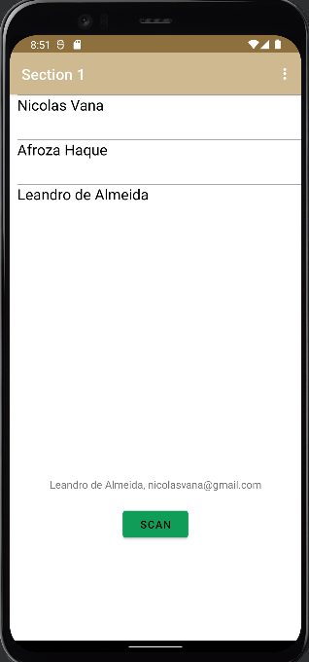
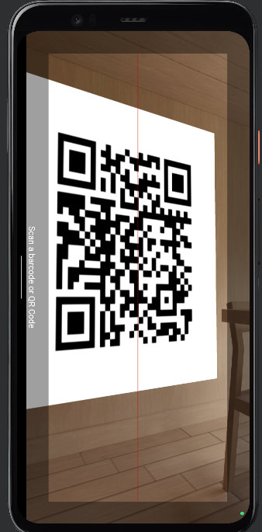
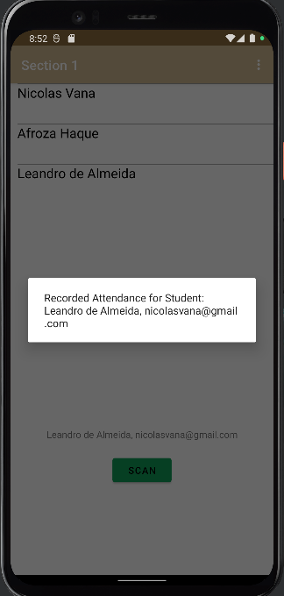
Continuous QR code Scanning

Slide 11
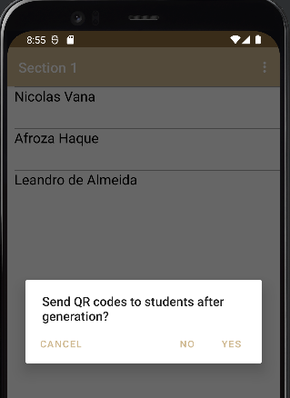
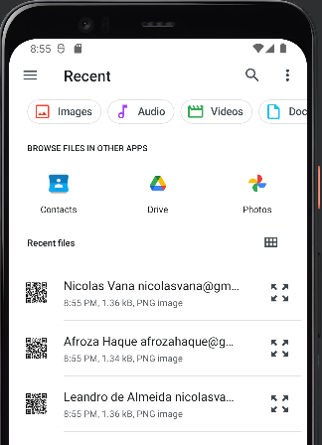
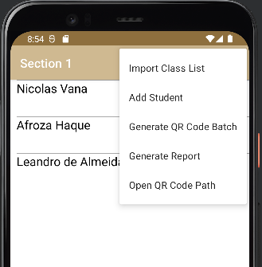
Batch QR code generation

Slide 12
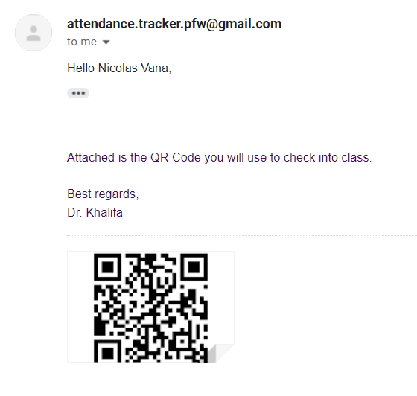
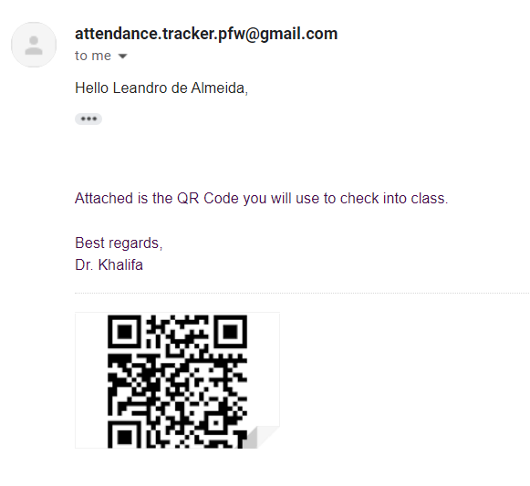
Batch QR code email distribution

Slide 13
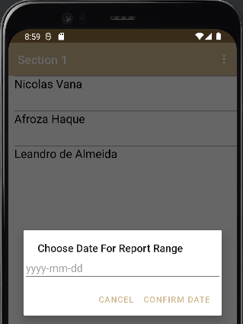
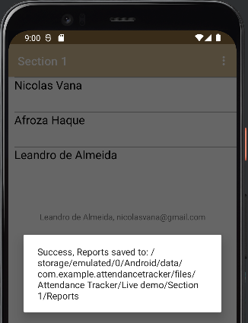
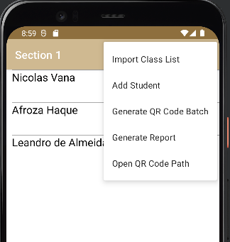
Report generation

Slide 14
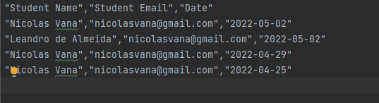
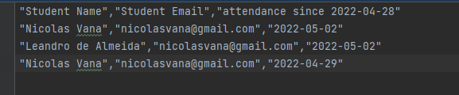
Report generation
All attendance report
Attendance since report

Slide 15
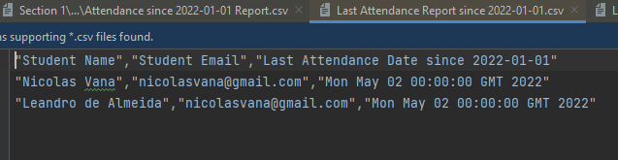
Report generation
Last attendance report

Slide 16
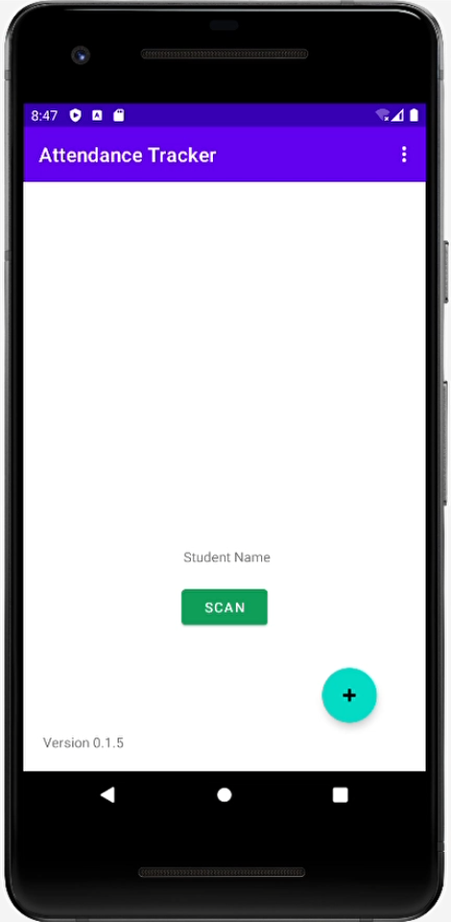
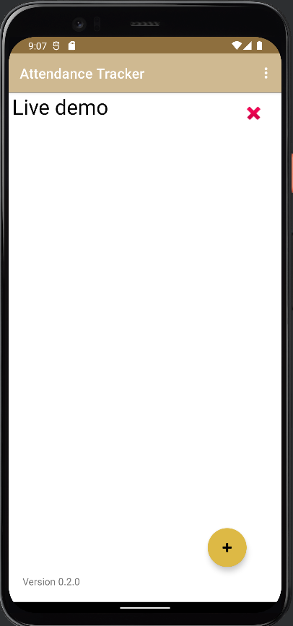
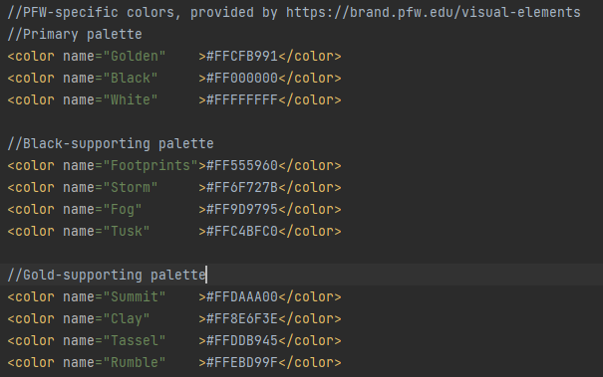
Color Scheme Change
Before
After

Slide 17
Live Demo

Slide 18
Tools
Java and Android Studio to Develop the app
ZXing library to generate QR Codes
Bitbucket to store code and documentation
TinyDB to save data

Slide 19
Risk vs Solution
Tight Schedules – Project management tool Jira​
Device incapable of scanning QR code - Install external QR code scanner
Technical difficulties due to lack of industry experience – Learning new tools and concepts to complete the project

Slide 20
Project Learning Outcomes
Project Management​
Importance of teamwork​
Converting the requirements to product​
Learnt more about software development and testing​
Application of software engineering concepts like UML diagrams, cohesion, coupling etc.​
Understanding Android development frameworks
Usage of Android Studio as a facilitator for building Android applications

Slide 21
Project Management
We have used Jira software to keep track of project progress and of the tasks to be completed
Division of tasks was based on group assessment of the difficulty of each task
Weekly meetings were carried out in order to re-assess and re-distribute tasks if required
There were no hardware or software costs associated with this project

Slide 22
Questions?

Slide 23
References
[1] A. Nuhi, A. Memeti, F. Imeri, and B. Cico, “Smart Attendance System using QR Code,” 2020 9th Mediterr. Conf. Embed. Comput. MECO 2020, pp. 8–11, 2020, doi: 10.1109/MECO49872.2020.9134225.
[2] K. Navin, A. Shanthini, and M. B. Mukesh Krishnan, “A mobile based smart attendance system framework for tracking field personals using a novel QR code based technique,” Proc. 2017 Int. Conf. Smart Technol. Smart Nation, SmartTechCon 2017, pp. 1540–1543, 2018, doi: 10.1109/SmartTechCon.2017.8358623.

Slide 24
Thanks!
Nicolas Vana - santn01@pfw.edu
Afroza Haque - haqua01@pfw.edu
Leandro de Almeida - almel01@pfw.edu

